Slide 1
Computer Organisation
Topic 6
Addressing Modes and Instruction Formats
Hamacher et al., Computer Organisation (5th Ed.), Chap. 2
Stallings, Computer Organization & Architecture (9th Ed.), Chap. 13

Slide 2
Outline
Addressing modes
  Immediate
  Direct
  Indirect
  Register
  Register Indirect
  Displacement
Instruction Formats

Slide 3
Addressing Modes
To achieve this, various addressing modes are employed
Trade-off
  Address range/addressing flexibility
  Number of memory references/complexity of address calculation
Notes:
So what are the addressing mode? It is basically we want to achieve various addressing mode to be able to access different parts of the memory
Therefore, we want to get as many location that are addressable as possible…but of course we will encounter some trade off….due to the limited number of bits available in the address field, so the address range will be limited and that definitely affect the addressing flexibility.
Due to the addressing mode that are available, there are also be different numbers of memory references that need to be made…therefore in order for us to calculate the addresses in order for us to access those location, sometimes there will be a processing overhead

Slide 4
Addressing Modes
Address field(s) in instruction format are relatively small
Need to be able to reference a large range of locations in main memory/virtual memory

Slide 5
ADD
A
B
6 bits
8 bits
8 bits
Memory
256 locations
4G locations
??
Notes:
In this example, we might have an instructions, and in this example we have a 22 bits sinstructions, 6 bit were for the opcode, and then we have 2 address field…
We only 8 bits, we can reference to 256 locations…but let say the memory has 4G location, so how do we reference the other remaining location? This will be the challenge addressing the location, and therefore the addressing modes comes in…..

Slide 6
Rough Analogy
Address
  401/G31
  School of Computer Science
  Universiti Sains Malaysia

Slide 7
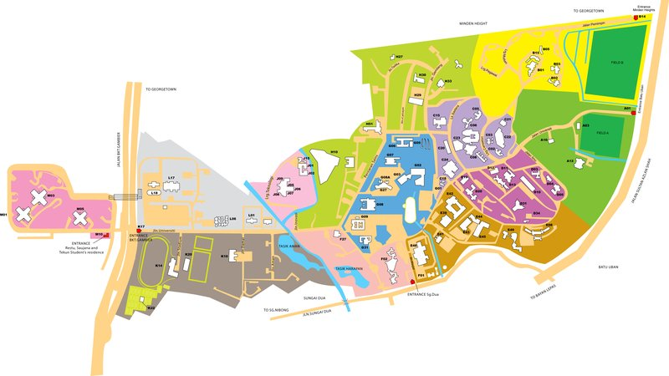
Rough Analogy

Slide 8
Immediate Addressing
Operand is part of instruction
Operand = address field
e.g. ADD 5
  Add 5 (the operand) to contents of accumulator
Notes:
Okay let’s start with the most basic, the most fundamental addressing mode…this is the immediate addressing mode
This is common on 1-address mode

Slide 9
Immediate Addressing
No memory reference to fetch data (pro)
Fast (pro)
Limited range (con) - limited to the size of the address field
Data is constant at run time
Notes:
No memory reference because the operand is already in the instructions…once we get the location, we don’t have to do any references in order to get the value of the operand
Data is constant at run time = that’s mean once you have assigned a value, let say you add 5, that 5 going to be fixed already

Slide 10
Immediate Addressing Diagram
Instruction
Opcode
Operand
e.g.
ADD
5

Slide 11
Immediate Addressing Diagram
Opcode
Operand
6 bits
26 bits
Assuming operand is a number. What is the largest operand possible?
What do you need to express a larger operand? More …..?

Slide 12
Direct Addressing
Address field contains address of operand
Effective address (EA) = address field (A)
e.g. ADD A
  Add contents of cell A to accumulator
  Look in memory at address A for operand
Notes:
The address of the operand is what we called the effective address…so whenever we say the effective address, that mean we are talking about the address of the operand itself.
An example is like ADD A, this A is the address of the operand which mean we need to add the content of a memory location called A to the accumulator…so basically we have to go to the location A to get the operand

Slide 13
Direct Addressing
Single memory reference to access data (pro)
No additional calculations to work out effective address (pro)
Limited address space (con)
Constant address. Data may change at run time
Notes:
In order to achieve it, we are doing 1 memory reference that means from the instruction itself, we need to jump once….we need to do 1 reference to the memory in order to get the operand
In this case, there is no additional calculations in the address field because it is already the address that you need to go to in order to fetch the operand
In this case, the address is constant, but the data may change…since the data is stored somewhere in the memory, so that data might be changing but the address is constant

Slide 14
Direct Addressing Diagram
Instruction
Opcode
Address A
Memory
A
Operand
Notes:
You jump once in order for you to reference the memory

Slide 15
Direct Addressing Diagram
Instruction
Opcode
Address A
Memory
6 bits
26 bits
A
Operand
Now, what is the largest operand possible?
How many memory reference locations available?
32 bits

Slide 16
Indirect Addressing
Memory cell pointed to by address field contains the address of (pointer to) the operand
2 memory access required:
  one for effective address
  another for operand
Notes:
The interesting here is that the memory cell pointed to by the address field contain the address of the operand….that mean when you see the address in the instruction, that address is not the operand, that address DOESN’T contain the operand, rather that address points to yet another address that points to the operand
In this case, you need to 2 memory access….you need to jump twice….first jump to get the effective address, the second jump is for you to get the operand
It requires two jump it arrive at the operand

Slide 17
Indirect Addressing
EA = (A)
  Look in A, find address (A) and look there for operand
e.g. ADD (A)
  Add contents of cell pointed to by contents of A to accumulator

Slide 18
Indirect Addressing Diagram
Instruction
Opcode
Address A
Memory
A
Pointer to operand
Operand

Slide 19
Indirect Addressing Diagram
Add (A),R0
A
B
B
Operand
Notes:
You go to A, to look for B which B is the effective address of the operand….So you jump from the instruction to A and then from A that contain the effective address of the operand to B, the operand

Slide 20
Indirect Addressing
Large address space (pro)
Range of effective address is 2^{n} where n = memory word length
Number of locations to hold effective address constrained to 2^{k} where k = width of instruction’s address field
Notes:
The advantage is now you have larger address space because the effective address now is in the memory and all the bits can be used to do the referencing
In the instruction field, that address A is where the K is…but once you go into the memory, you have entire n bits to reference the operand

Slide 21
Indirect Addressing
May be nested, multilevel, cascaded
  EA = (. . . (A) . . .)
Multiple memory accesses to find operand (con)
Hence slower (con)
Notes:
Nested – after jumping twice, you might not arrive at the operand, you might need to jump more than twice…it could be possible for you to do more reference before you get to the operand

Slide 22
Indirect Addressing Diagram
Instruction
Opcode
Address A
Memory
6 bits
26 bits
A
Pointer to operand
32 bits
Now, what is the largest operand possible?
How many memory reference locations available?
Operand
32 bits

Slide 23

Structure
The CPU
CPU
Computer
Arithmetic
and
Login Unit
I/O
Registers
System
Bus
CPU
Internal CPU
Interconnection
Memory
Control
Unit
Source: https://www.flickr.com/photos/nubui/9550939064
Notes:
If we recall, CPU is part of the overall computer structure, and within CPU, there are few components that are very important….so among them …….

Slide 24
Register Addressing
Similar to Direct Addressing
Operand is held in register named in address filed
EA = R [address of the register]
Limited number of registers
  Smaller range of address
Notes:
Register addressing is very much similar to direct addressing mode
But in this case, the operand is held in the register, so that mean the instruction contain an address but that address refers to the register

Slide 25
Register Addressing
Very small address field needed (pro)
  Shorter instructions
  Faster instruction fetch
No memory access (pro)
Very fast execution (pro)
Very limited address space (con)
Notes:
The advantage is that we only need to reference to very limited range of register….so a very small address field is needed. Therefore, the instruction maybe shorten, and the instruction fetch may also be faster
Another advantage is there no more memory access…that mean from the instruction itself, you going to refer to register ….not to another memory locations in the normal main memory …. But you going to refer to the location in the register

Slide 26
Register Addressing
Multiple registers helps performance
  Especially when operand in register remains in use for multiple operations
  Requires good assembly programming or compiler writing
  N.B. C programming
    register int a;

Slide 27
Register Addressing Diagram
Instruction
Opcode
Register Address R
Registers
R
Operand
Note that operand is in register

Slide 28
Register Indirect Addressing
Similar to indirect addressing
EA = (R)
Operand is in memory cell pointed to by contents of register R
Notes:
The effective address in this case is what is pointed by the register…that mean the register contain the address of the operand

Slide 29
Register Indirect Addressing
Large address space (2^{n}) (pro)
Multiple memory accesses to find operand (con)
But one fewer memory access than indirect addressing (i.e. one register and one memory access)

Slide 30
Register Indirect Addressing Diagram
Instruction
Opcode
Register Address R
Memory
Registers
R
Pointer to Operand
Operand
Notes:
2 jumps

Slide 31
Register Indirect Addressing Diagram
Add (R1),R0
Main
memory
B
Operand
R1
B
Register

Slide 32

Direct/Indirect vs Register/Register Indirect
What’s the main difference?

Slide 33
Displacement Addressing
Combines direct addressing and register indirect addressing
EA = A[main memory] + (R) [register]
Address field hold two values
  A [main memory] = base value (explicit)
  R [main memory] = register that holds displacement, or vice versa
Notes:
Combine direct addressing and register indirect addressing…which mean part of the addressing mode involves looking at the content in the memory and combine with a particular content of the register…so it involves both memories as well as the register, so the effective address here is whatever that is pointed to the main memory address and also added with some content from the register
Normally for this case, register will holds the displacement value (offset) and the main memory will hold the base value…but there are also times where register will hold the base value and main memory hold the displacement value
In computer architecture and assembly language programming, displacement addressing is a method of addressing memory locations by specifying the displacement or offset from a base address. The base address is typically stored in a register, and the displacement is added to or subtracted from this base address to determine the effective address of the operand.
The offset, also known as the displacement, represents the distance (in bytes or words) from the base address. The effective address is calculated as follows:
Effective Address=Base Address+OffsetEffective Address=Base Address+Offset

Slide 34
Displacement Addressing
Common uses of displacement addressing:
  Relative addressing
    used in branch instructions (e.g., conditional jumps) where the target address is specified as an offset relative to the current instruction pointer or program counter.
  Base-register addressing
    commonly used for accessing elements in arrays or structures. The base register holds the starting address, and the displacement is added to it to access a specific element.
  Indexing
    involves multiplying an index by a scale factor and using the result as the displacement. This is particularly useful for accessing elements in arrays.

Slide 35
Displacement Addressing Diagram
Instruction
Displacement/offset
Opcode
Register R
Address A
Memory
Registers
Base
R
Pointer to Operand
+
Operand
Notes:
Register R referred to the content in the register, and it then added to the address A which it gives you the calculated address, and that calculated address is the EFFECTIVE address which then point to the operand in the main memory

Slide 36
Displacement Addressing Diagram
Add 1000(R1),R2
+
Index register
1000
20
R1
20 = offset
= 1020
1020
Operand
Offset is in the index register

Slide 37
Displacement Addressing Diagram
Add 20(R1),R2
+
1000
1000
R1
20 = offset
= 1020
1020
Operand
Offset is given as a constant in instruction

Slide 38
Example using Displacement Addressing
Suppose we wish to compute sum of all scores on 3 tests in memory locations SUM1, SUM2, and SUM3

Slide 39
Example using Displacement Addressing
Address of 1st student
Accumulated Test 1
N
n
Accumulated Test 2
Move #LIST,R0
LIST
Student ID
Accumulated Test 3
Clear
R1
Clear
R2
LIST + 4
Test 1
Number of students
Clear
R3
Student 1
Offset based on student address to access test
LIST + 8
Test 2
Move
N,R4
LOOP
Add
4(R0),R1
LIST + 12
Test 3
Add
8(R0),R2
LIST + 16
Student ID
Go to next student address
A
d
d
12(R0),R3
Reduce number of student to process
Test 1
Add
#16,R0
Student 2
Decrement
R4
Test 2
Branch>0
LOOP
Test 3
Move
R1,SUM1
Move
R2,SUM2
Move
R3,SUM3
Indexed addressing used in accessing test scores in the list
A list of students' marks
Notes:
R0 wil contain the address of the first student, if you can see in the memory, there are various location to store the student ID, the subsequent memory will then store the test marks of that particular student…after the test 3 marks, then only we see the ID of the next student…every subsequent student will be an offset of 16,

Slide 40
Relative Addressing
A version of displacement addressing
R = Program counter, PC
EA = A + (PC)
  Current instruction address is added to the address field
i.e. get operand from A cells from current location pointed to by PC
c.f concept of locality of reference & cache usage
Notes:
Make use of the program counter..what happen is that the address in the address field is then added with the program counter content…for this addressing mode, we are capitalising on the concept of the locality….because the program counter always point to the next instruction …so when we want to point to that memory location that are near to the instruction, then we use relative addressing mode

Slide 41
Relative Addressing Diagram
Instruction
Opcode
Address A
Memory
Program Counter
PC Address
+
Operand

Slide 42
Base-Register Addressing
A holds displacement
R holds pointer to base address (of a segment)
R may be explicit or implicit
e.g. segment registers in 80x86
Facilitates relocation of programs in memory (only the base register requires updating)
Also exploits the locality of memory references

Slide 43
Base-Register Addressing Diagram
Instruction
displacement
Opcode
Address A
Memory
Base Register
Base Address
+
Operand

Slide 44
Indexed Addressing
A = base
R = displacement (opposite of base-register addressing)
EA = A + (R)
Good for accessing arrays (autoindexing)
  EA = A + (R)
  R++

Slide 45
Indexed Addressing Diagram
Instruction
displacement
Opcode
Register R
Address A
Memory
Registers
R
Pointer to Operand
+
Operand

Slide 46
Stack Addressing
Stack pointer
  Address of the top of the stack
  Register
Register indirect addressing

Slide 47
Comparison
✓
✗
Immediate
Limited operand magnitude
No memory reference
Direct
Simple
Limited address space
Indirect
Multiple memory references
Large address space
Register
No memory reference
Limited address space
Register indirect
Large address space
Extra memory references
Displacement
Flexibility
Complexity
Stack
No memory reference
Limited applicability

Slide 48
Displacement vs
Relative vs
Base Register vs
Indexed vs Stack
What’s your observation?
Any similarities/differences?

Slide 49
Outline
Addressing modes
Instruction Formats

Slide 50
Instructions Formats
Layout of bits of an instruction
Must include
  Opcode
  Operands (>= 0) (implicitly or explicitly)
  Addressing mode (implicitly or explicitly)
Notes:
An instruction format defines the layout of the bits of an instruction, in terms of its constituent fields.
For most instruction sets, more than one instruction format is used.

Slide 51
Key Issues
Instruction length
  Affects (or affected by) memory size, memory organisation, bus structure, processor complexity, and processor speed.
  Trade-off
    Powerful instruction vs save space
Notes:
The most basic design issue to be faced is the instruction format length.
This decision affects, and is affected by, memory size, memory organization, bus structure, processor complexity, and processor speed.
This decision determines the richness and flexibility of the machine as seen by the assembly-language programmer
‘
The most obvious trade-off here is between the desire for a powerful instruction repertoire and a need to save space.
Programmers want more opcodes, more operands, more addressing modes, and greater address range. More opcodes and more operands make life easier for the programmer, because shorter programs can be written to accomplish given tasks.
Similarly, more addressing modes give the programmer greater flexibility in implementing certain functions, such as table manipulations and multiple-way branching.
memory can become a bottleneck if the processor can execute instructions faster than it can fetch them. One solution to this problem is to use cache memory (see Section 4.3); another is to use shorter instructions.

Slide 52
Key Issues
Allocation of bits
  Number of addressing modes
    Implicit - opcode might always call for indexing
    Explicit – One or more mode bits are needed
  Number of operands
    Typical instructions format – 2 operands
  Register vs memory
  Number of register sets
  Address range
  Address granularity
Variable-length instructions
Notes:
how to allocate the bits in that format.
More opcodes obviously mean more bits in the opcode field. For an instruction format of a given length, this reduces the number of bits available for addressing.
The following interrelated factors go into determining the use of the addressing bits.
Register versus memory: A machine must have registers so that data can be brought into the processor for processing. With a single user-visible register (usually called the accumulator), one operand address is implicit and consumes no instruction bits. However, single-register programming is awkward and requires many instructions.
Number of register sets: Most contemporary machines have one set of general purpose registers, with typically 32 or more registers in the set. These registers can be used to store data and can be used to store addresses for displacement addressing
Address range: For addresses that reference memory, the range of addresses that can be referenced is related to the number of address bits

Slide 53
PDP Instructions Formats
PDP-11
  16, 32 & 48 bit instruction lengths
  13 different formats (of various lengths and bit allocations)
  opcodes vary from 4 bits to 16 bits
  rich set of addressing modes
  addressing modes depend on operand, not opcode - independence from opcode - orthogonality
  increase hardware cost and complexity (con)
  can develop efficient and compact programs (pro)
Notes:
PDP-11 The PDP-11 was designed to provide a powerful and flexible instruction set within the constraints of a 16-bit minicomputer
The PDP-11 employs a set of eight 16-bit general-purpose registers. Two of these registers have additional significance: one is used as a stack pointer for special-purpose stack operations, and one is used as the program counter, which contains the address of the next instruction.

Slide 54
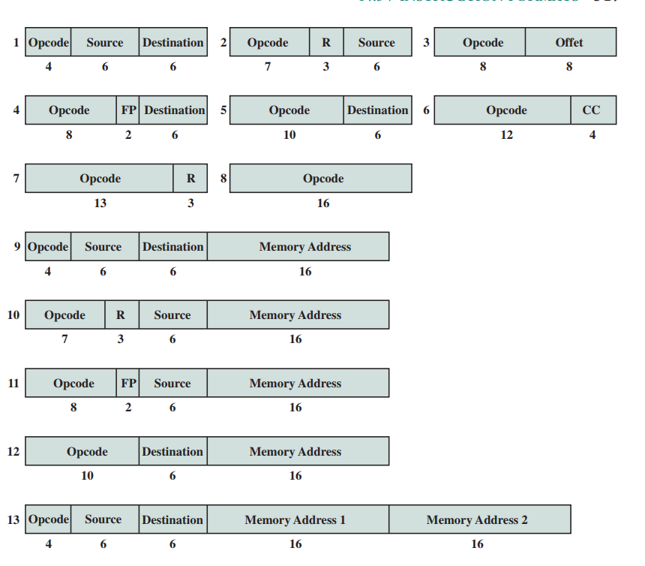
Notes:
shows the PDP-11 instruction formats. Thirteen different formats are used, encompassing zero-, one-, and two-address instruction types. The opcode can vary from 4 to 16 bits in length. Register references are 6 bits in length. Three bits identify the register, and the remaining 3 bits identify the addressing mode.

Slide 55
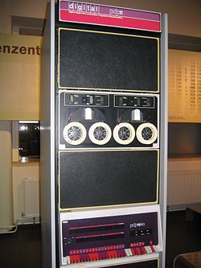
PDP Instructions Formats
PDP-11
Source: https://en.wikipedia.org/wiki/PDP-11#/media/File:Pdp-11-40.jpg

Slide 56
VAX Instructions Formats
VAX
  2 criteria in designing instruction format
    all instructions have ‘natural’ number of operands
    all operands have same generality in specification
  highly variable instruction format
  1- or 2-byte opcode
  0 to 6 operands
  minimum instruction length = 1 byte
  maximum instruction length = 37 bytes
  uses extended opcode with hexadecimal codes
Notes:
The VAX instruction begins with a 1-byte opcode.
This suffices to handle most VAX instructions.
However, as there are over 300 different instructions, 8 bits are not enough.
The hexadecimal codes FD and FF indicate an extended opcode, with the actual opcode being specified in the second byte.

Slide 57
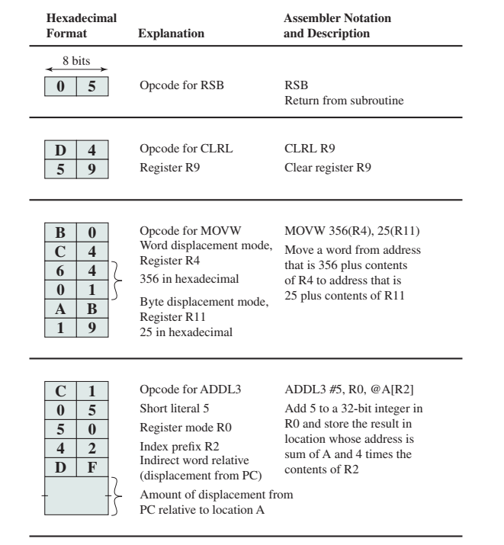
Notes:
The VAX instruction set provides for a wide variety of operations and addressing modes. This gives a programmer, such as a compiler writer, a very powerful and flexible tool for developing programs.

Slide 58
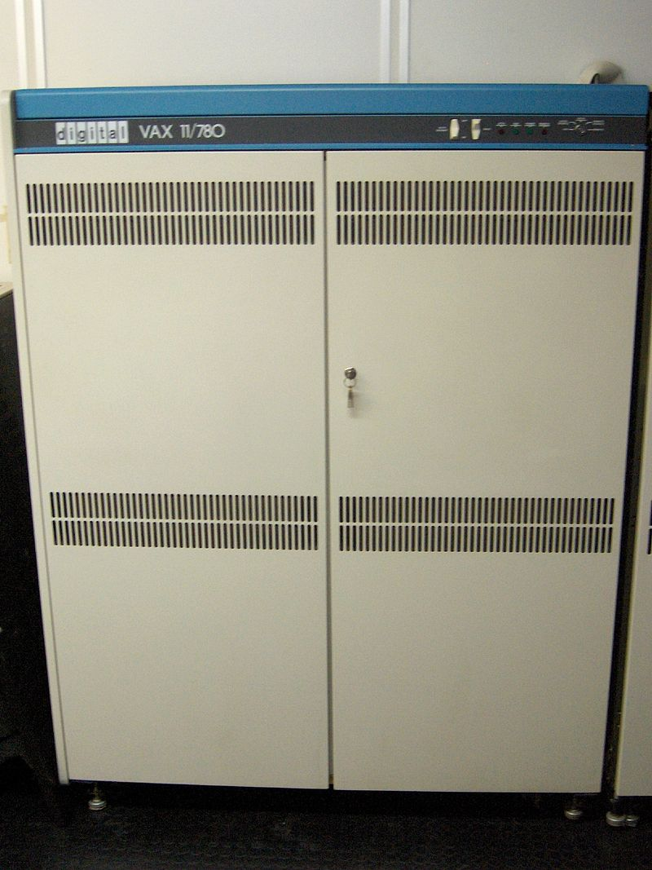
VAX Instructions Formats
VAX
Source: https://en.wikipedia.org/wiki/VAX#/media/File:VAX_11-780_intero.jpg

Slide 59
x86 Instruction Formats
Variety of instruction formats
Only opcode is always present
Instruction consists of:
  instruction prefixes (0 to 4) - optional Prefix bytes
  opcode
  address specifier - optional
    mod r/m byte
    scale index byte
  displacement - optional
  immediate field - optional
Instruction
fields
Notes:
Instructions are made up of from zero to four optional instruction prefixes, a 1- or 2-byte opcode, an optional address specifier (which consists of the ModR/M byte and the Scale Index Base byte) an optional displacement, and an optional immediate field.

Slide 60
x86 Instruction Formats
Prefix bytes:
  Instruction prefixes: LOCK prefix or one of a few repeat prefixes
    LOCK: to ensure exclusive use of shared memory (multiprocessor environment)
    Repeat prefixes (REP, REPE, REPZ, REPNE & REPNZ): for string processing
  Segment override: specifies segment register that an instruction should use (don’t use default)
  Address size: switch between 16- or 32-bit address
    determines displacement size and offsets during calculation of EA
  Operand size: switch between 16- or 32-bit operand

Slide 61
x86 Instruction Formats
Instruction fields:
  Opcode: 1, 2 or 3 bytes
  Mod r/m: addressing information
    specifies if operand is in register or memory
    if memory, bytes indicate addressing mode
    Mod r/m byte has 3 fields: Mod field, Reg/Opcode field & r/m field
  SIB (Scale Index byte): works with Mod r/m
    SIB has 3 fields: SS field (scaling factor), Index field (index register) & Base field (base register)
  Displacement: 8-, 16-, or 32-bit signed integer
  Immediate: 8-, 16-, or 32-bit operand

Slide 62
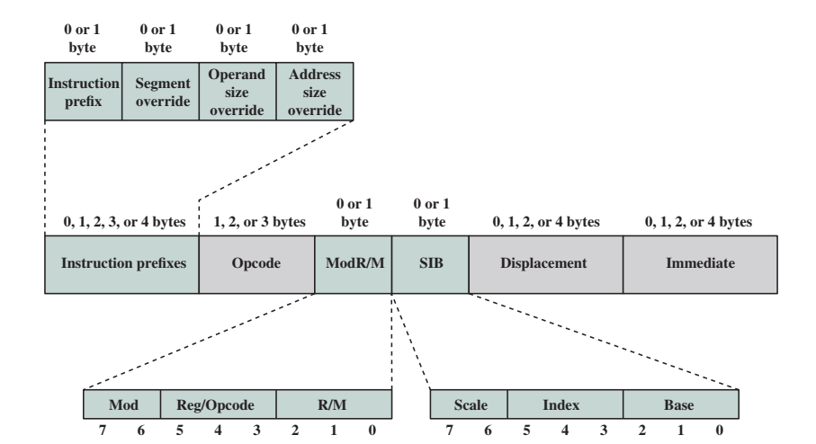
x86 Instruction Formats
Notes:
As can be seen, the encoding of the x86 instruction set is very complex. This has to do partly with the need to be backward compatible with the 8086 machine and partly with a desire on the part of the designers to provide every possible assistance to the compiler writer in producing efficient code.

Slide 63
PowerPC Instruction Formats
All instruction fixed length (32 bits)
Regular format (similar bit allocation)
e.g. Load/Store
6
5
5
16
bits
Ld/St
Indirect
Dest
Register
Base
Register
Displacement
e.g. Branch
6
5
5
16
bits
Branch
Conditional
Options
CR bit
Indirect through
Link or Count Reg
L

Slide 64
PowerPC Instruction Formats
e.g. Arithmetic
6
5
5
16
bits
Add, Sub,
etc.
Dest
Register
Src
Register
Signed Immediate
Value

